Slide 1

SOLAR METRICS
Unlock the Power of Savings with NOCT: Harnessing Accurate Calculations for Solar Modules!

Slide 2
The problem we are trying to solve
The existing procedure determining NOCT often produces inconsistent results. This can be problematic for solar panel manufacturers, installers, and investors who rely on accurate data to make informed decisions.

Slide 3
SOLAR METRICS SOLUTION
Using Machine Learning through Multilinear regression and Deep Learning to develop a tool that processes solar data accurately and determine better NOCT values

Slide 4

Few definitions....
NOCT: Nominal Operating Cell Temperature
a parameter used in the field of solar energy to help evaluating the performance and efficiency of solar panels

Slide 5

SOLAR METRICS APPROACH
Data source : The Photovoltaic Testing Laboratory
Machine learning Estimators used:
Multilinear Regression
Deep Learning

Slide 6
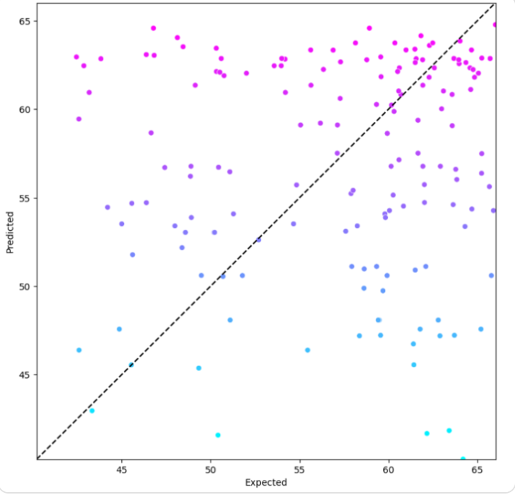
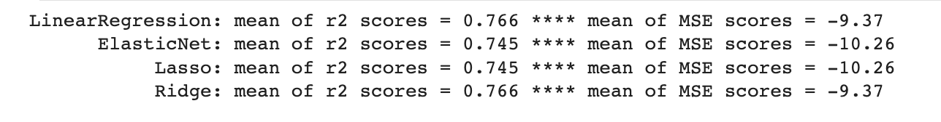
Multilinear Regression

Slide 7
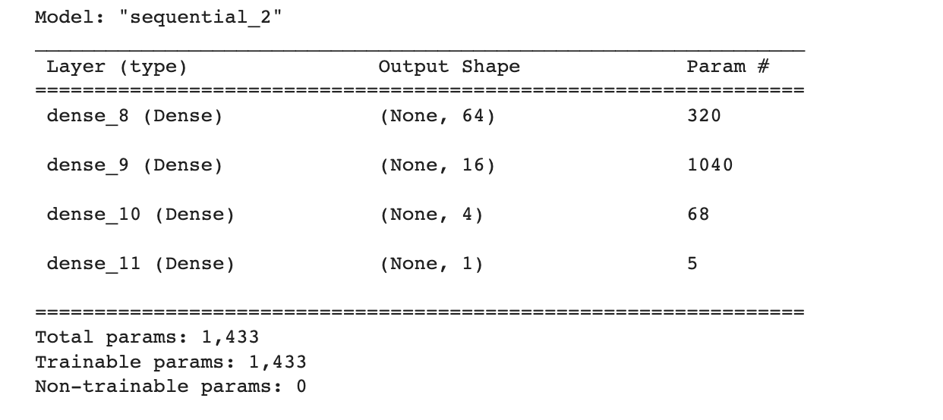
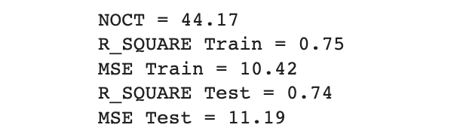
Deep learning

Slide 8

Solar Metrics Project Goal Achieved?
Yes!
Solar Metrics NOCT is predicted to be more accurate and more useful to investors!

Slide 9

What is Next?
Fine tuning the code:
Bar chart comparison
Enabling the "add button" for individual to provide their model
Include a CEC (Standard) Vs Solar Metrics NOCT comparison

Slide 10

TIME FOR DEMO!

